Slide 1
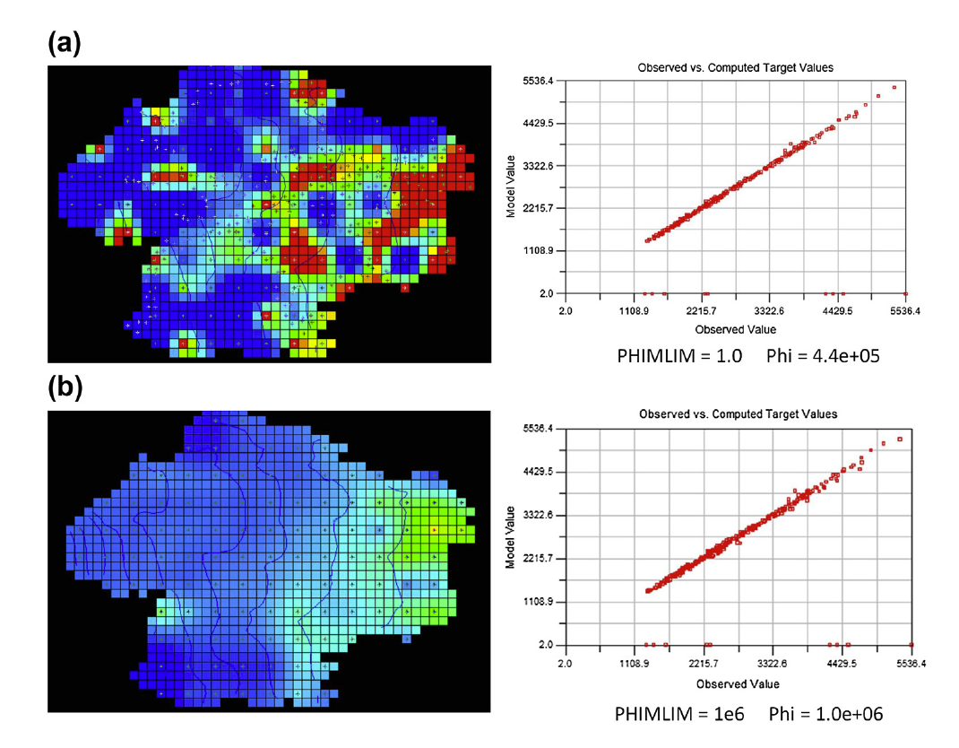
Problem History, Failure and Success: Background for Parameter Estimation and Uncertainty ACT 1
Fig. 9.16 Anderson et al. (2015)

Slide 2
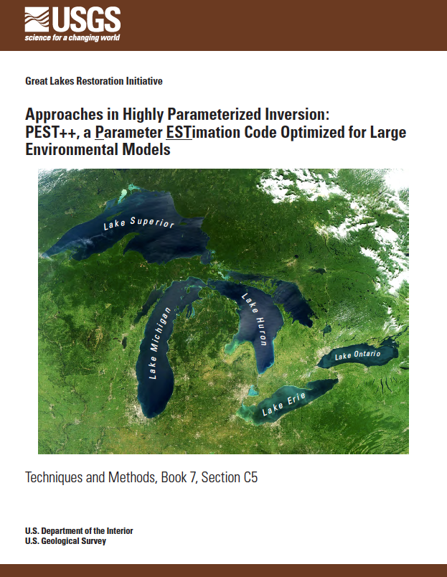
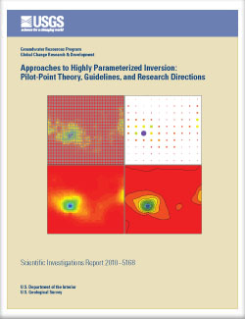
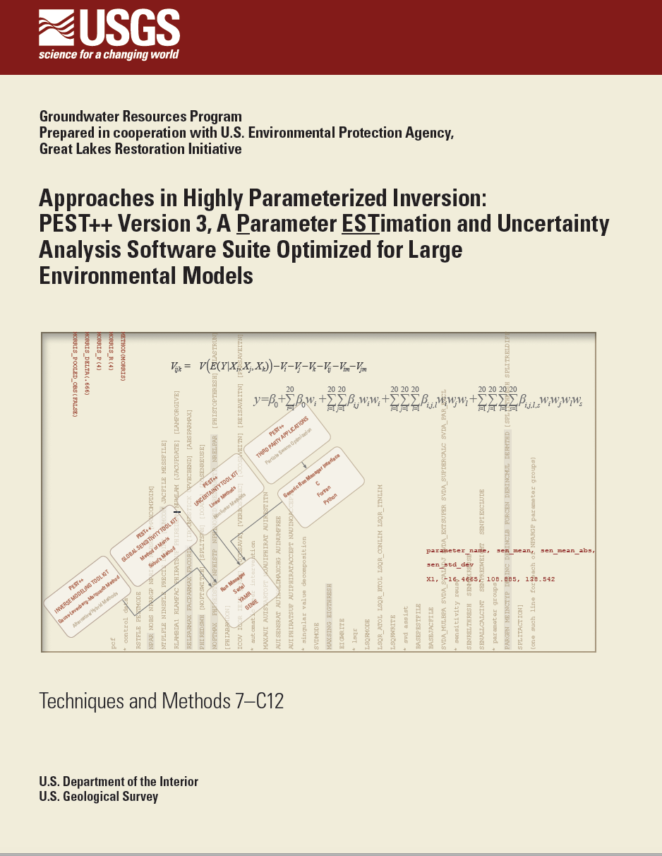
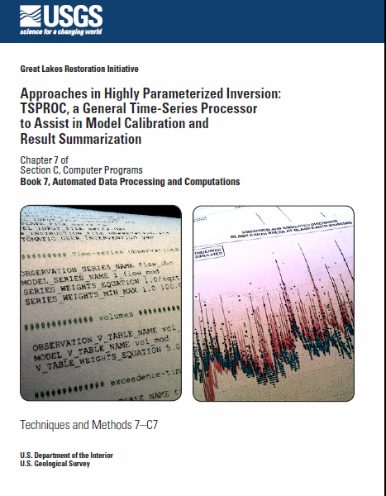
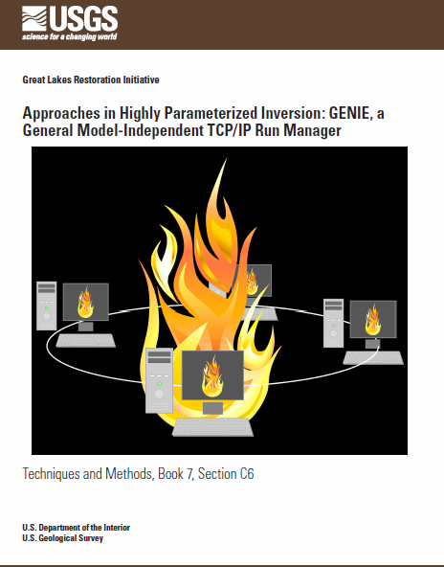
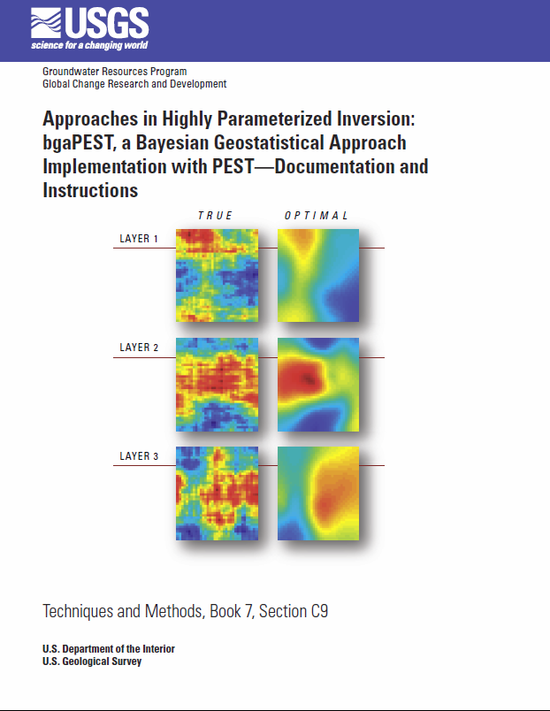
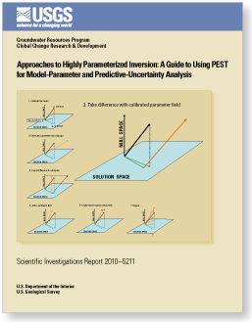
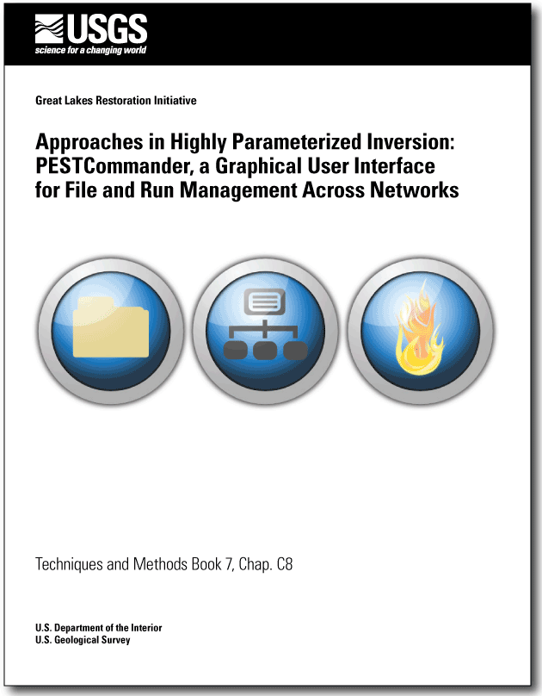

Slide 3
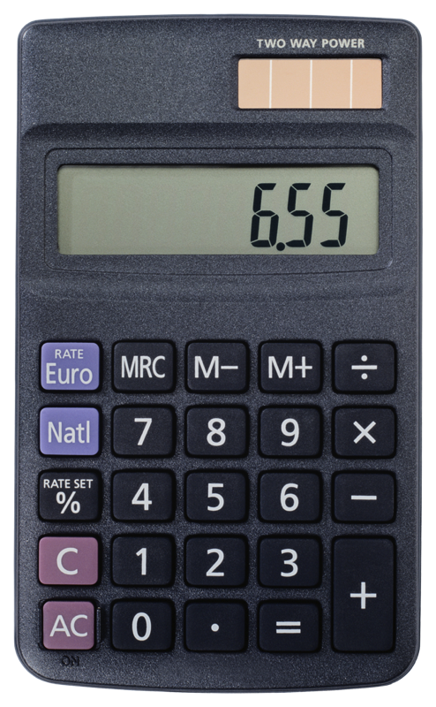
What is Parameter Estimation?
One of two “inverse methods”
What does “inverse” mean?
Forward Model
Inverse Model
Kh, Kv, recharge, Boundary Conditions
heads and fluxes
heads and fluxes
Kh, Kv, recharge, Boundary Conditions

Slide 4
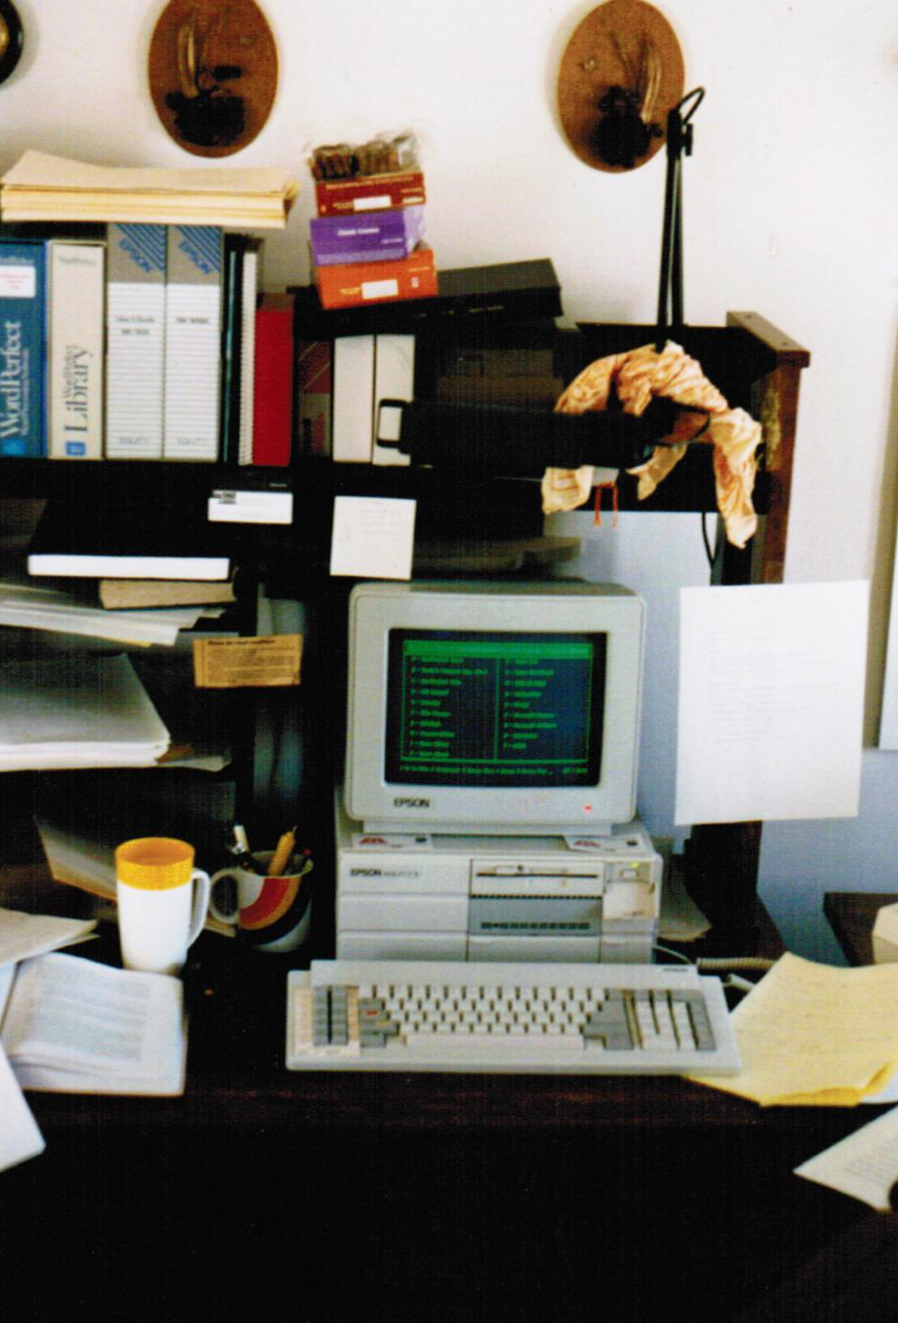
Early days, progress, and a conversion (well 2 conversions):
Bandanna
Girl Scout Cookies
WordPerfect
1986 XT with coproces-sor
F&C 1979
Madison, circa 1987

Slide 5

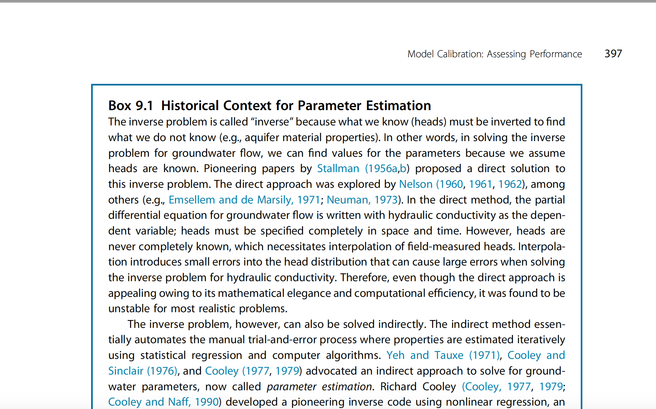
Two Inverse methods? (from Anderson et al. 2015)

Slide 6
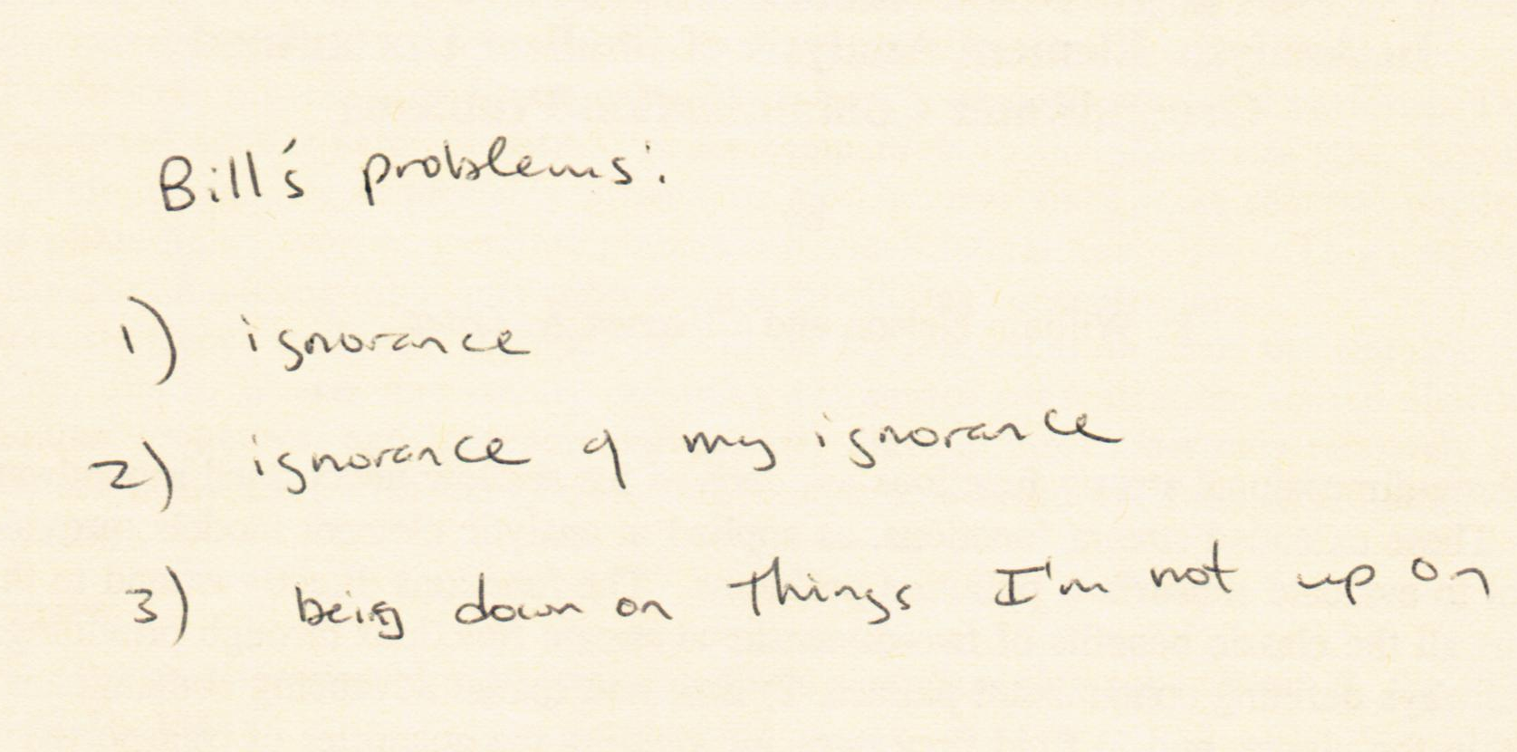
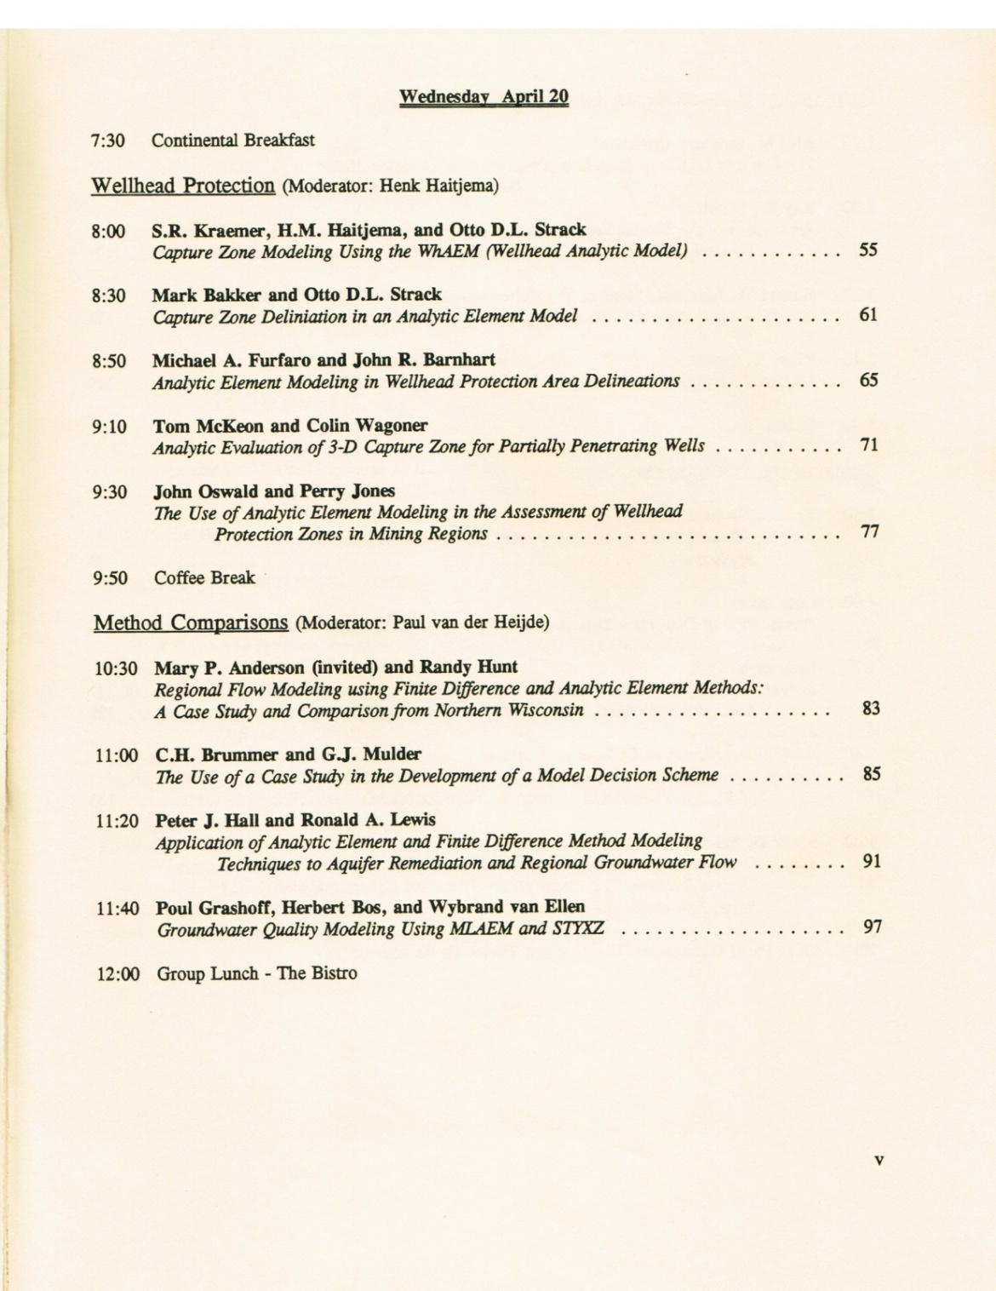
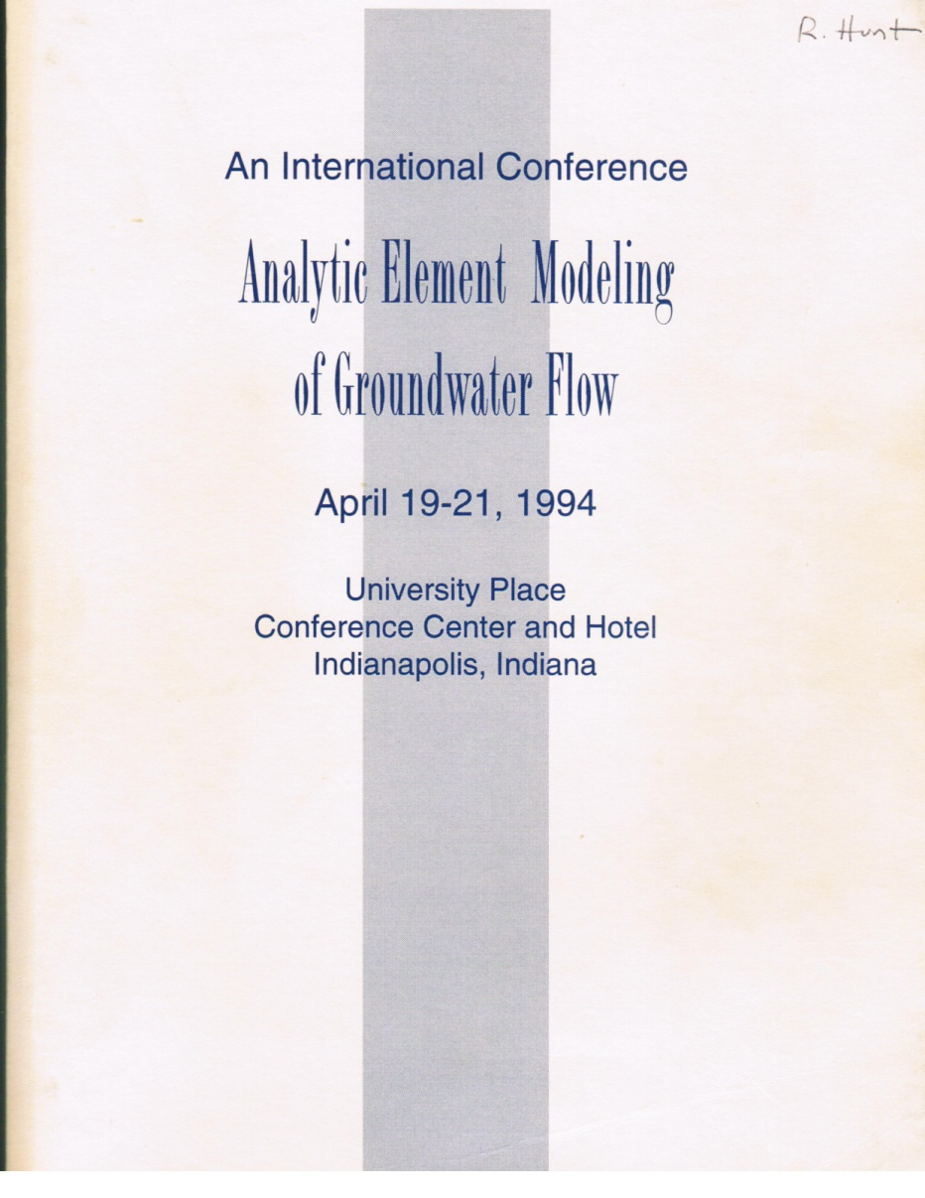
Meeting Bill Nelson, 1994
In the language of this course = reducing “structural error”

Slide 7
Two Inverse methods? (from Anderson et al. 2015)

Slide 8
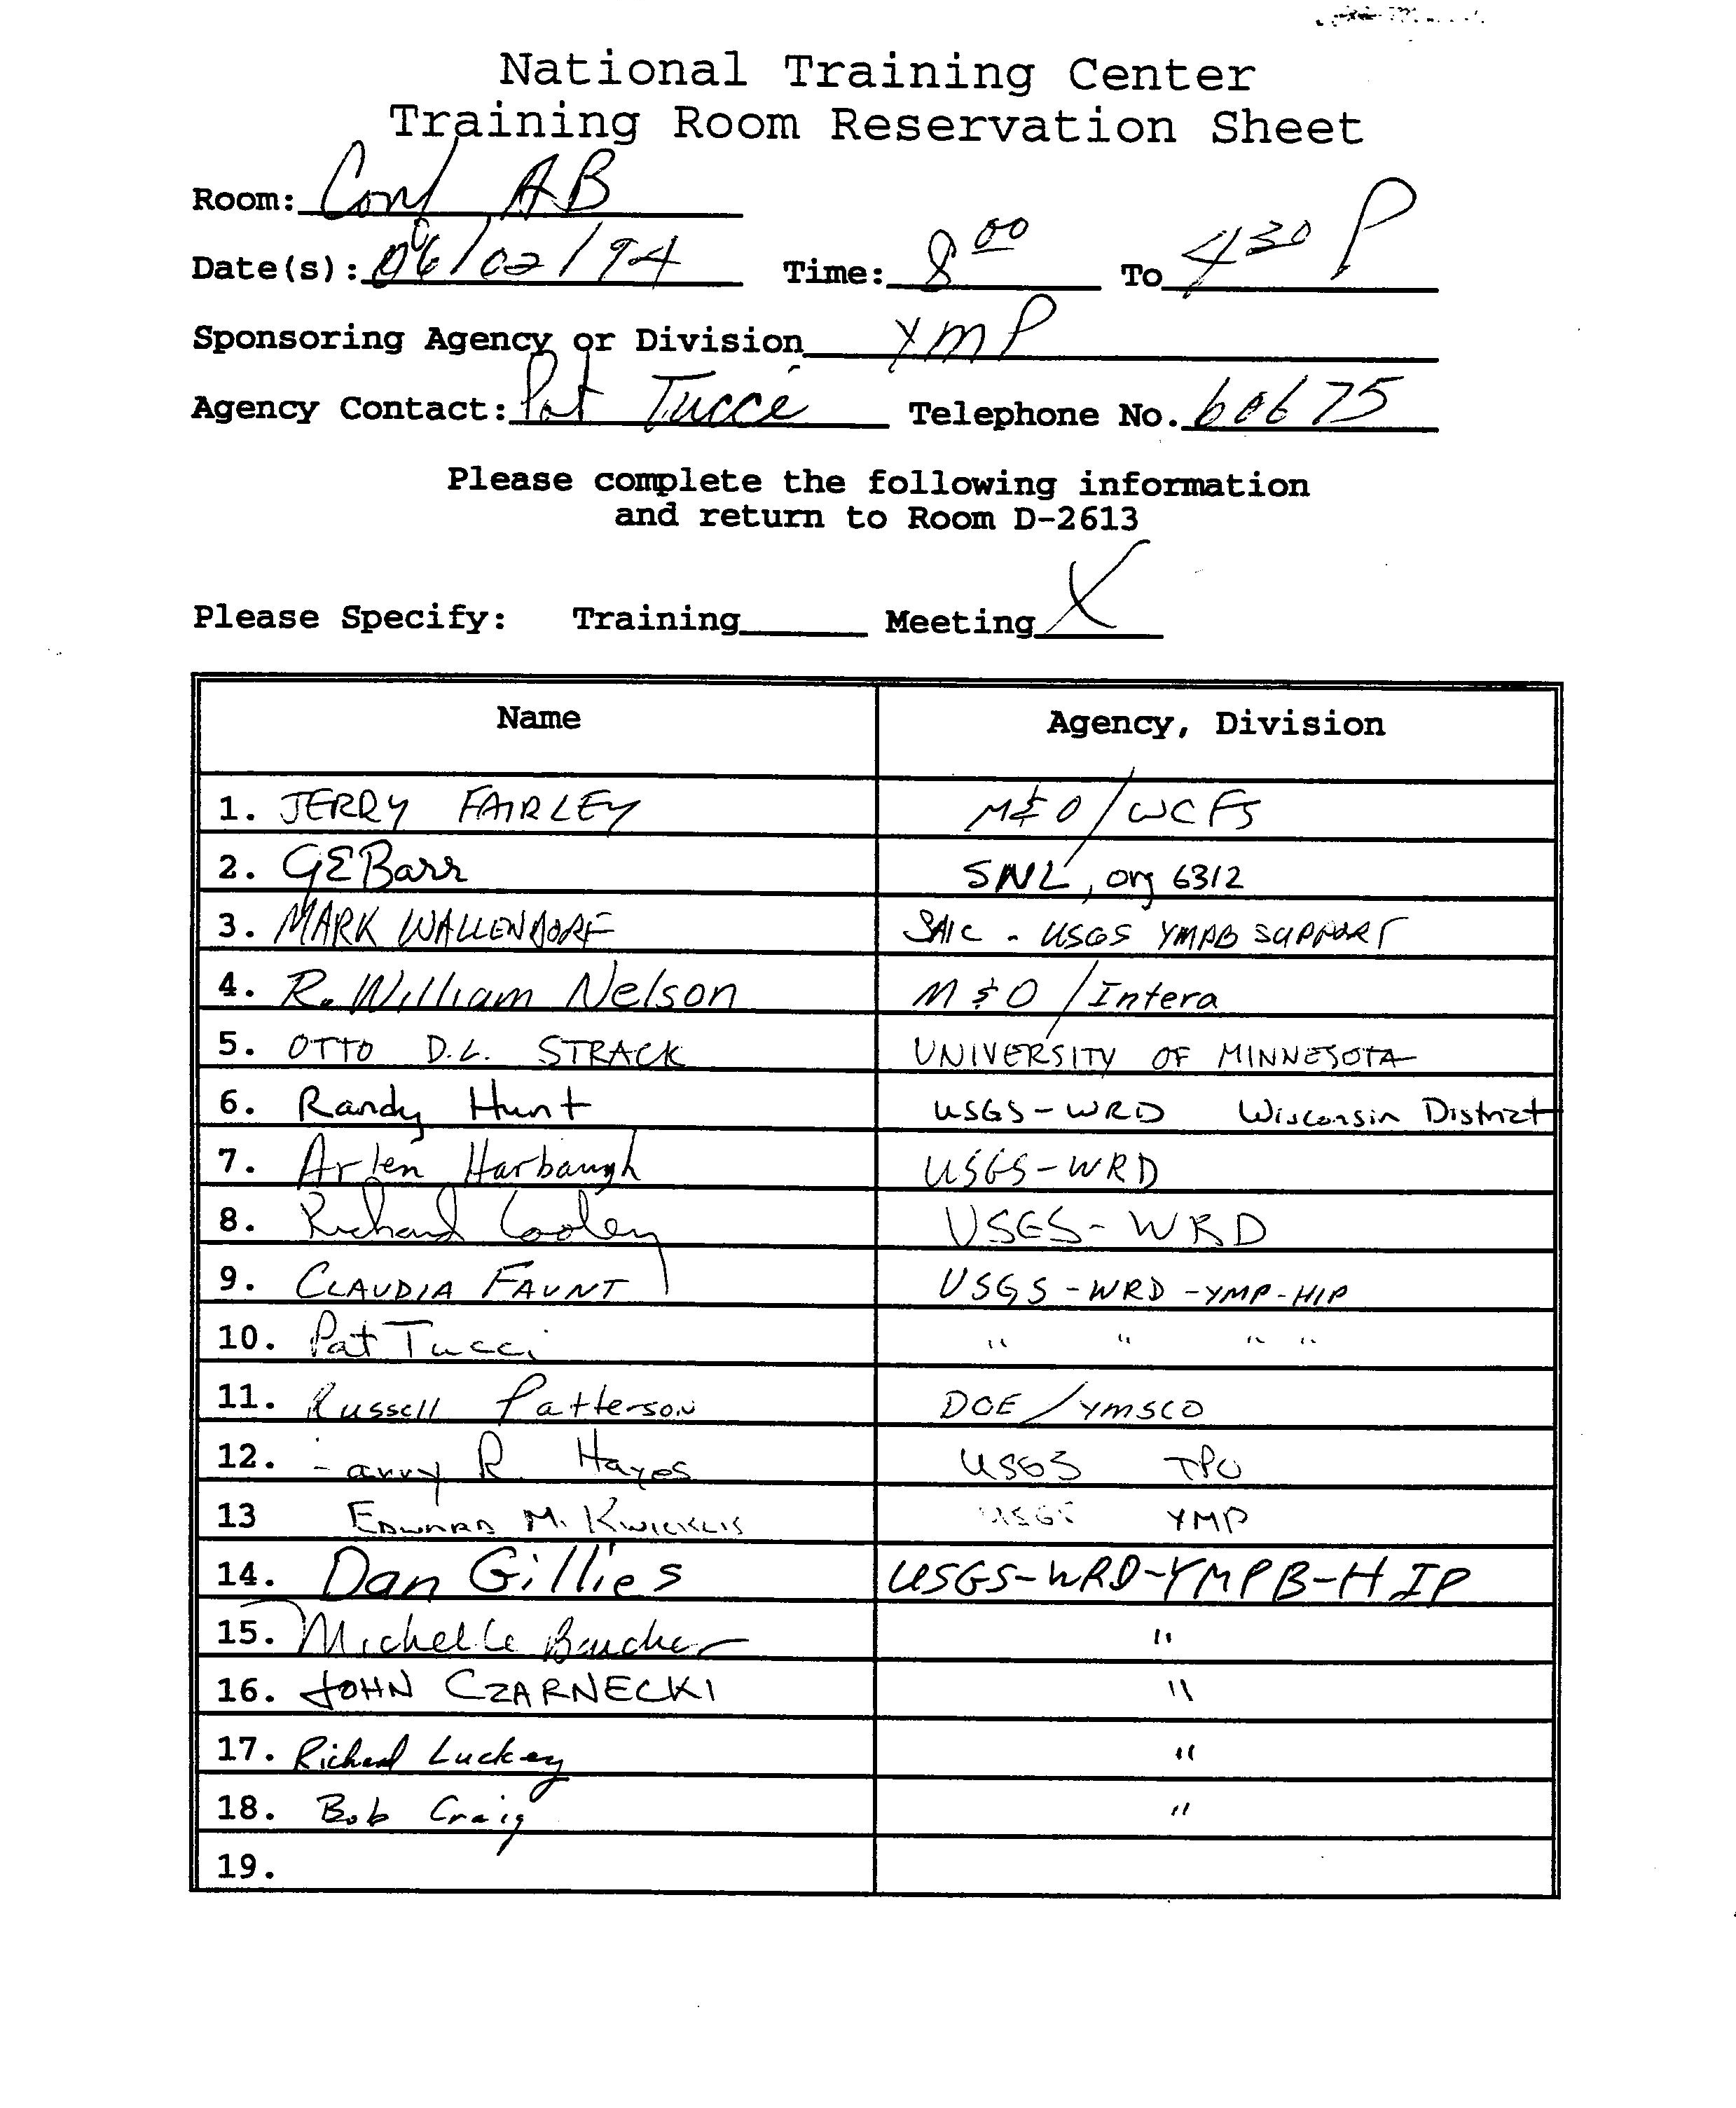
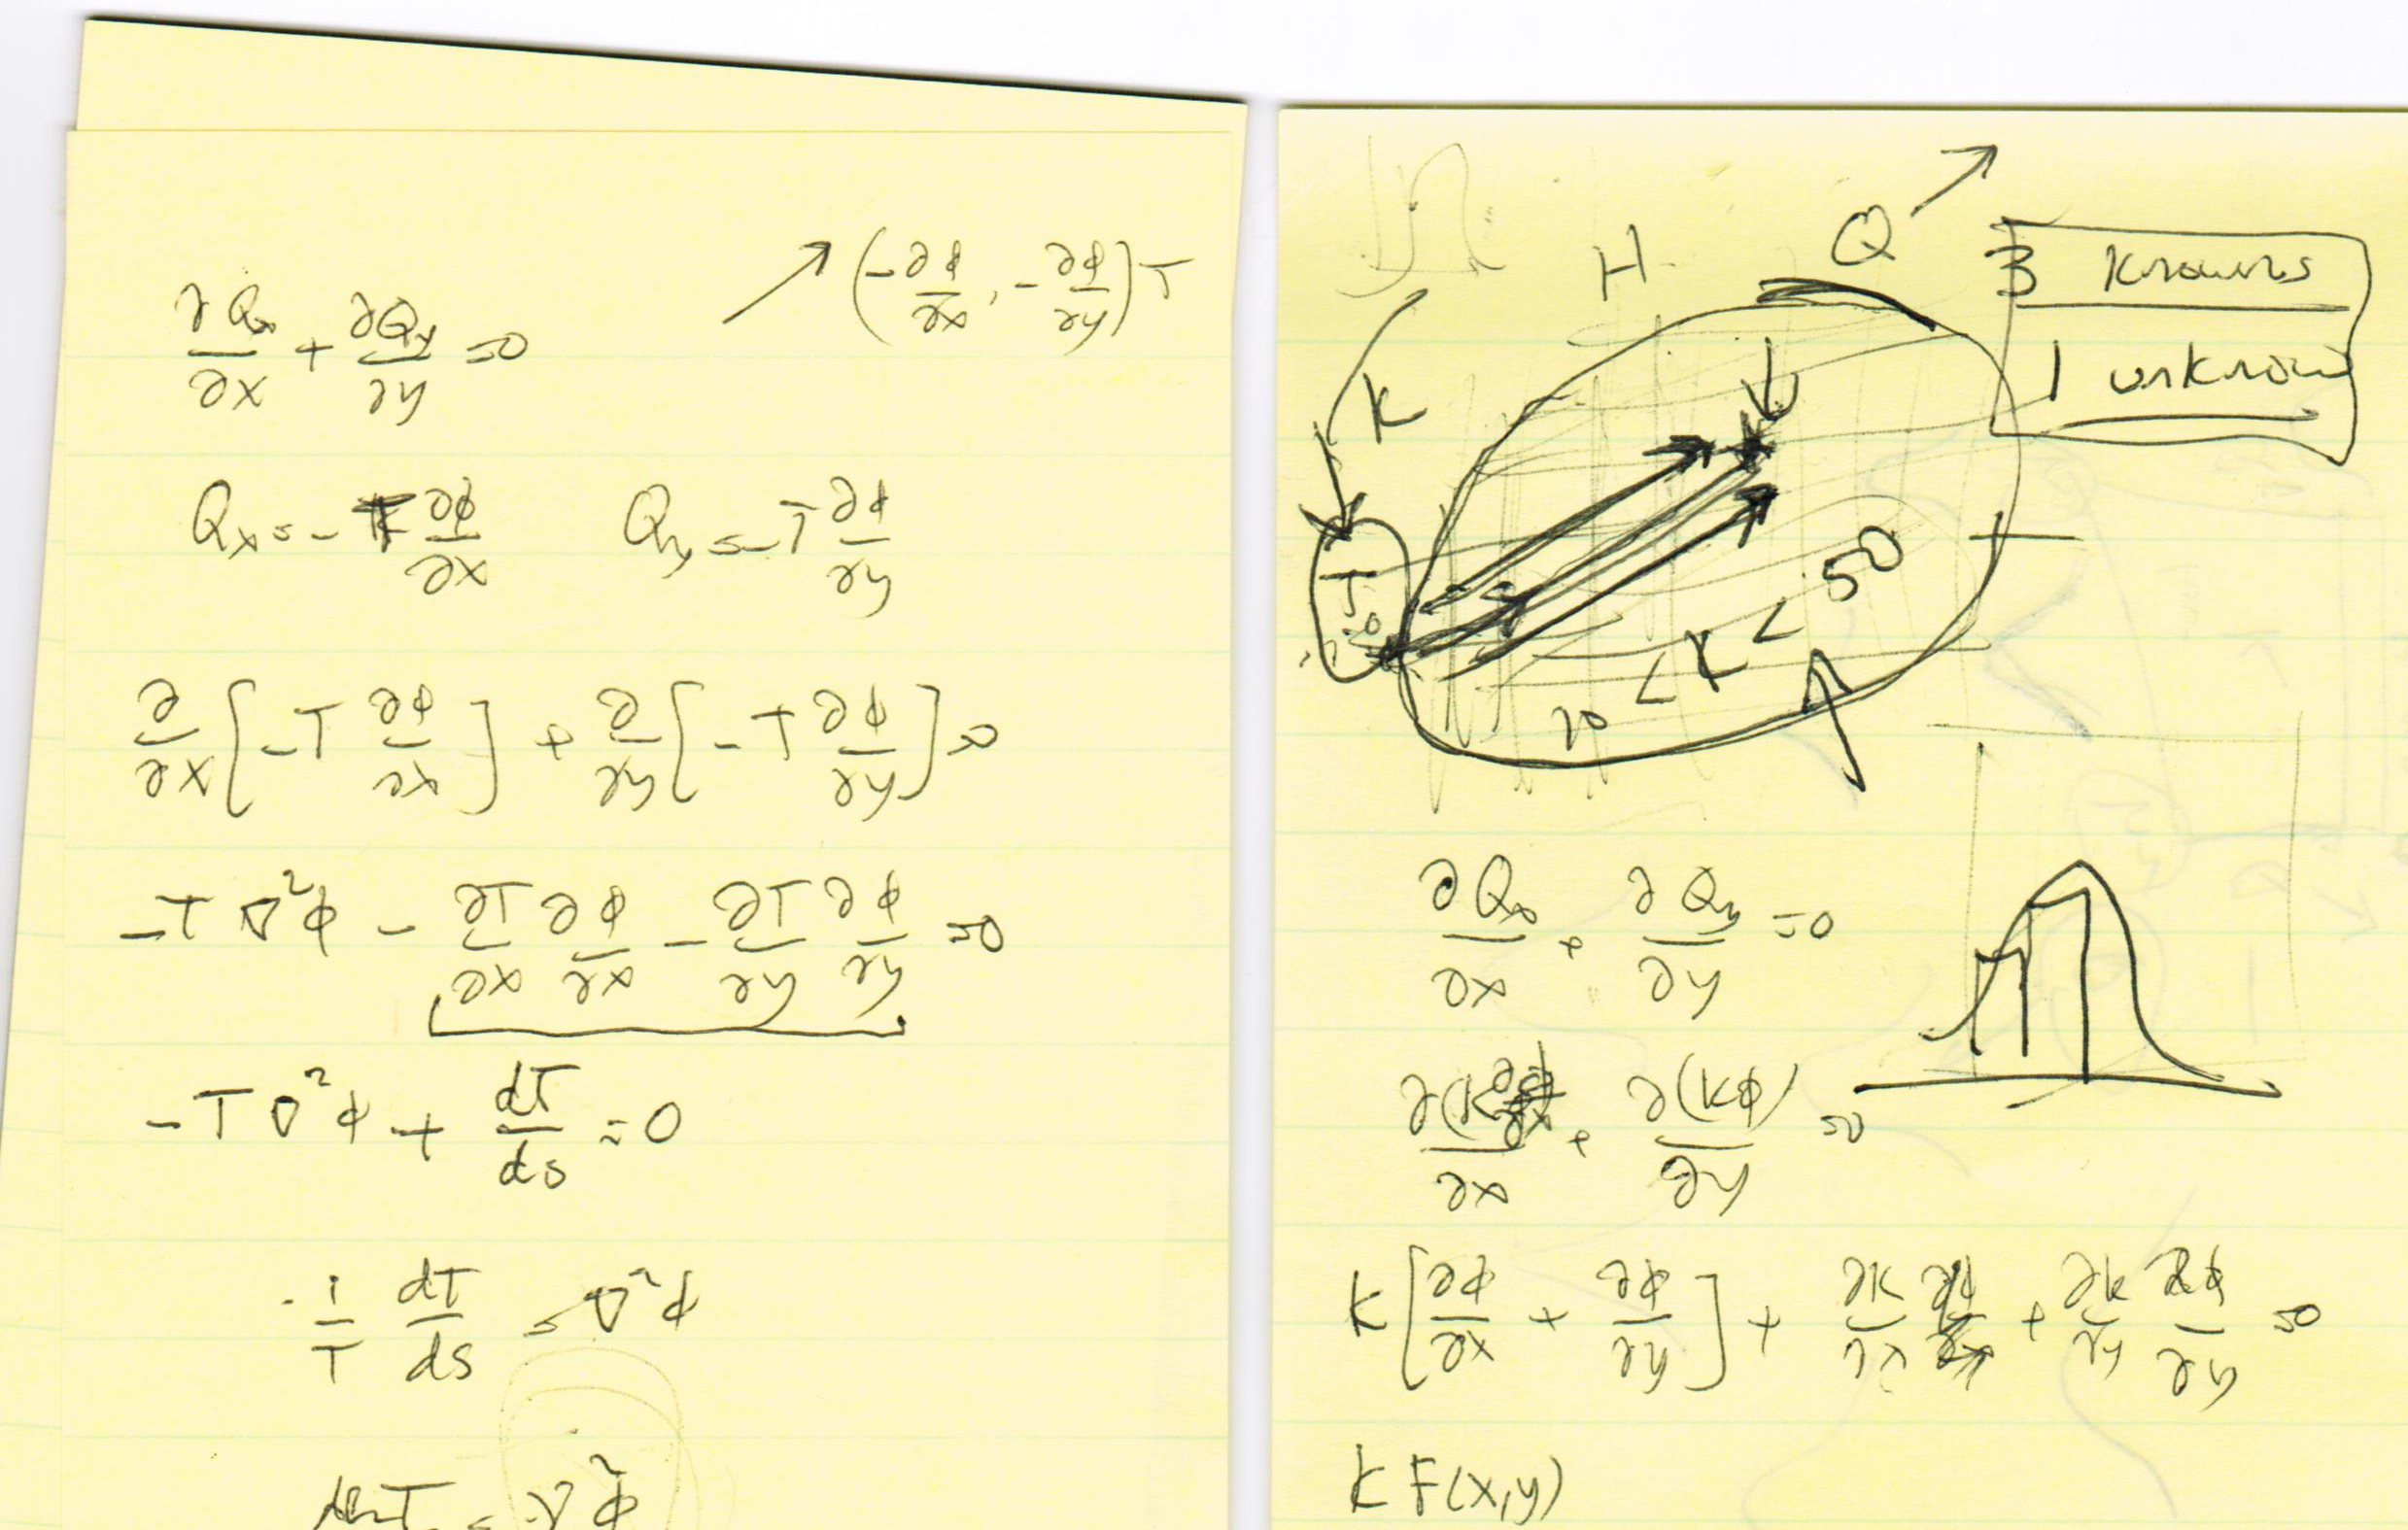
Meeting Dick Cooley, 1994

Slide 9

1987 Mary Stoertz
1987 Randy
Cooley’s model rocks! Inverse methods are great and should be applied to our problems
Spatial and temporal recharge is complex but often important
Inverse methods?! Machines calibrating models? I don’t think so!
Recharge – average areal rates work just fine for me!

Slide 10
1987 Mary Stoertz
2007 Randy
Cooley’s model rocks! Inverse methods are great and should be applied to our problems
Spatial and temporal recharge is complex but often important
I was a luddite, most models should have parameter estimation/uncertainty applied
Structural error – I was blind but now I see

Slide 11
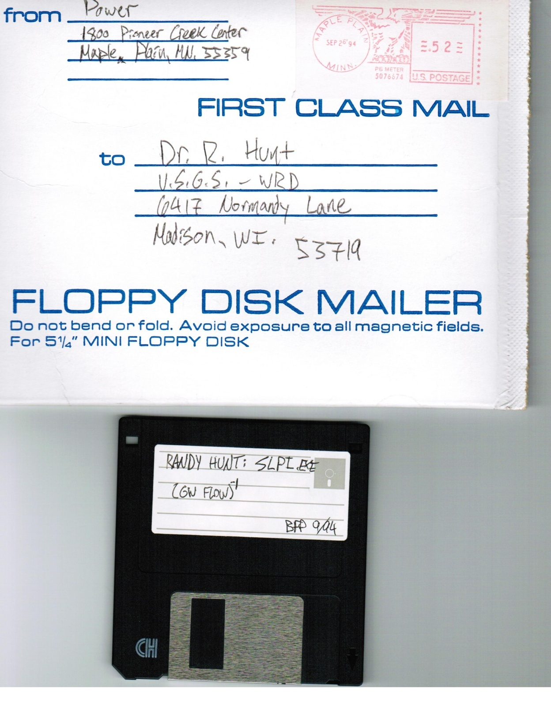
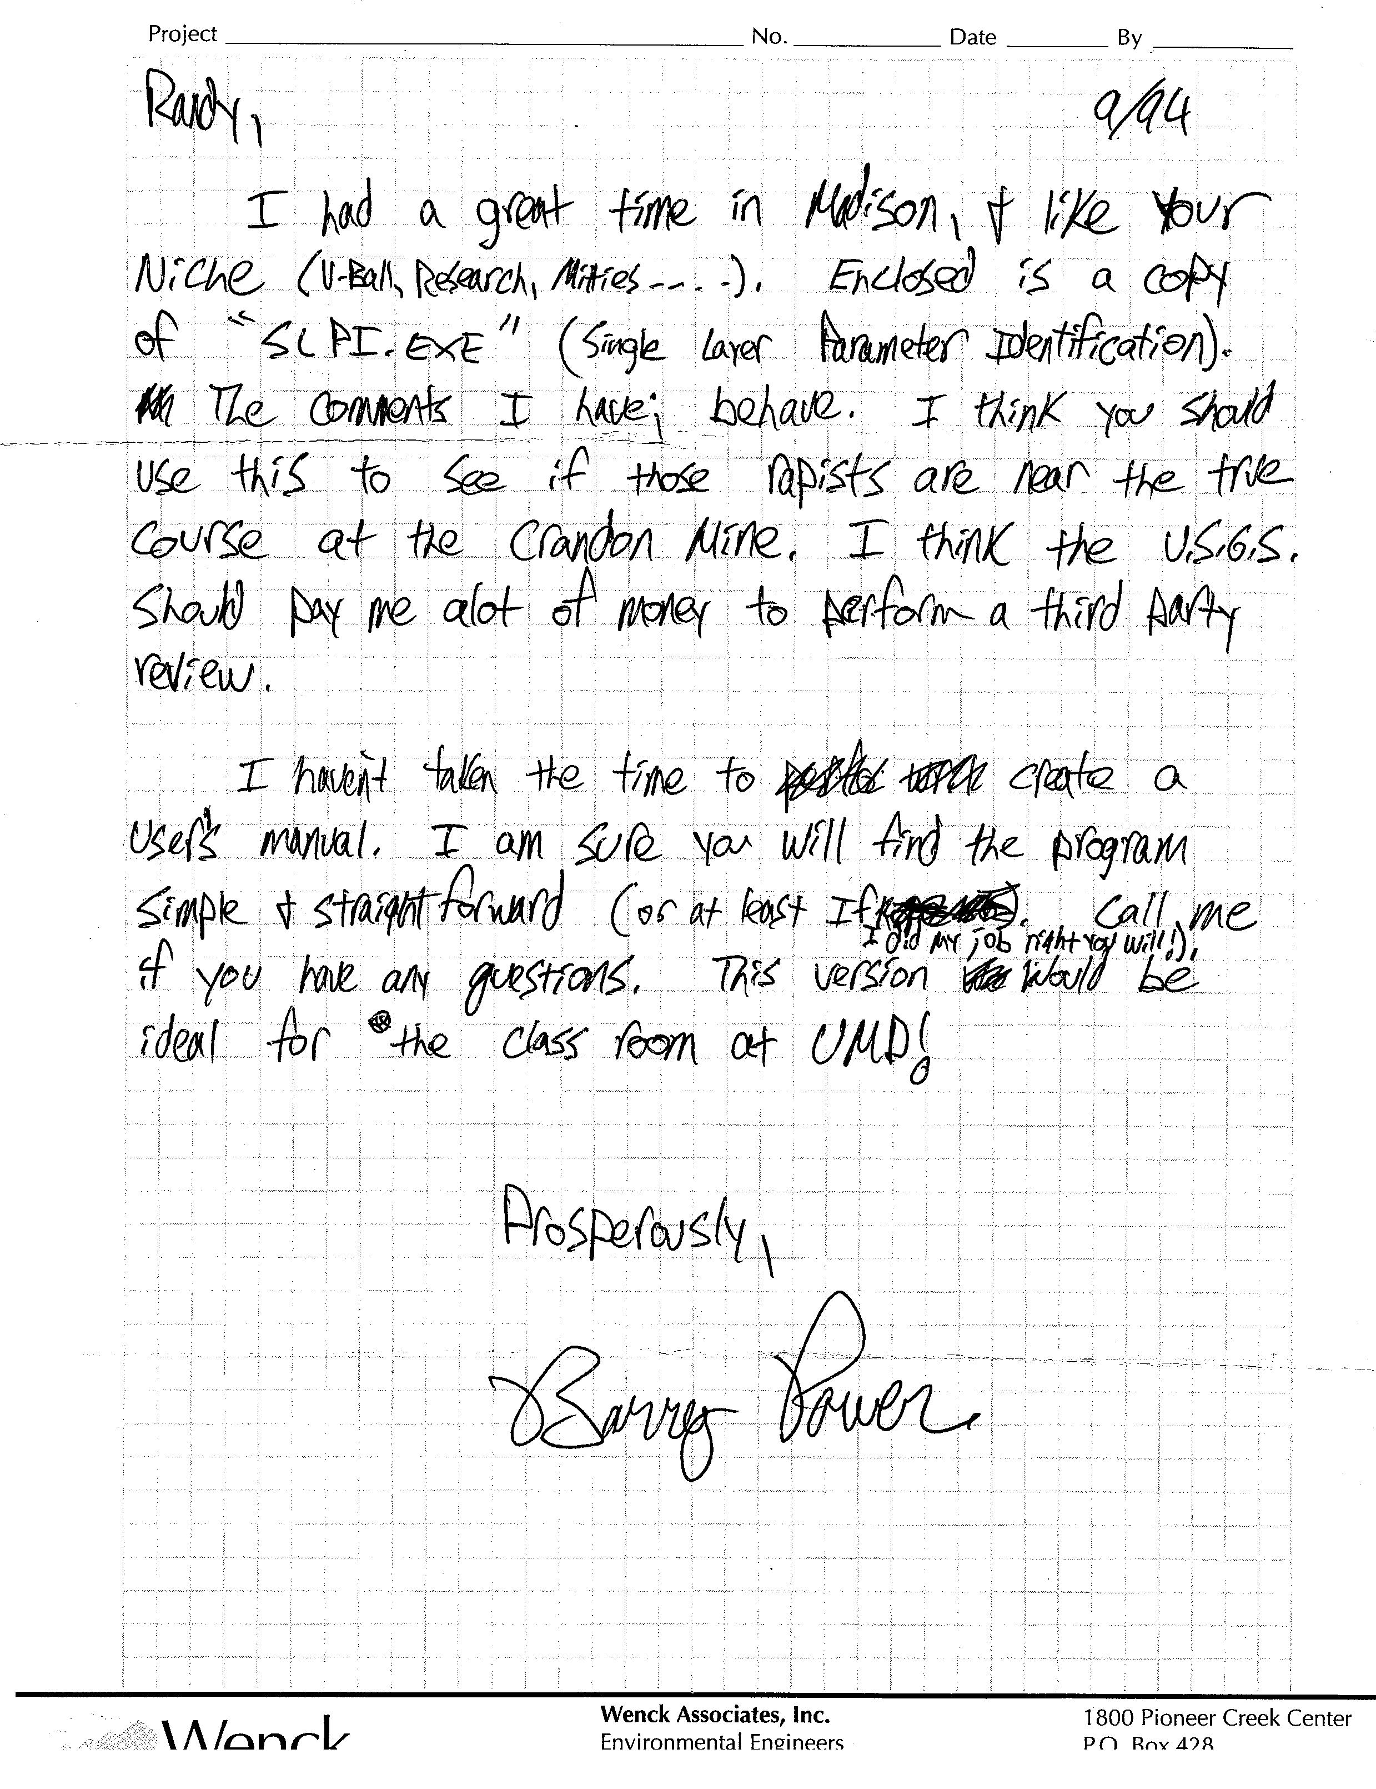
1994 – Indirect inverse, ..er…Parameter Estimation, special versions of codes
“Enclosed is a copy of SLPI.exe (single layer parameter identification). The comments I have: behave.”

Slide 12
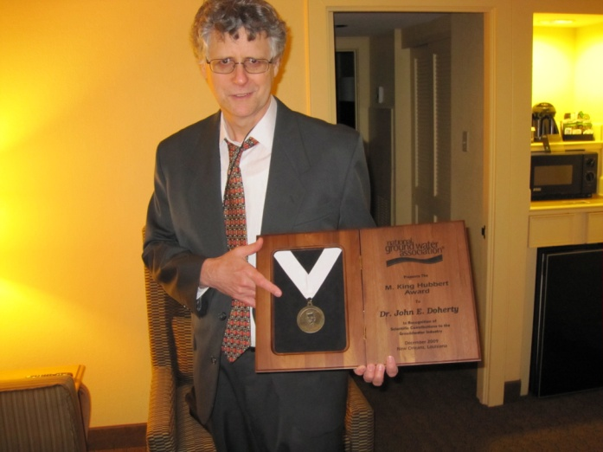
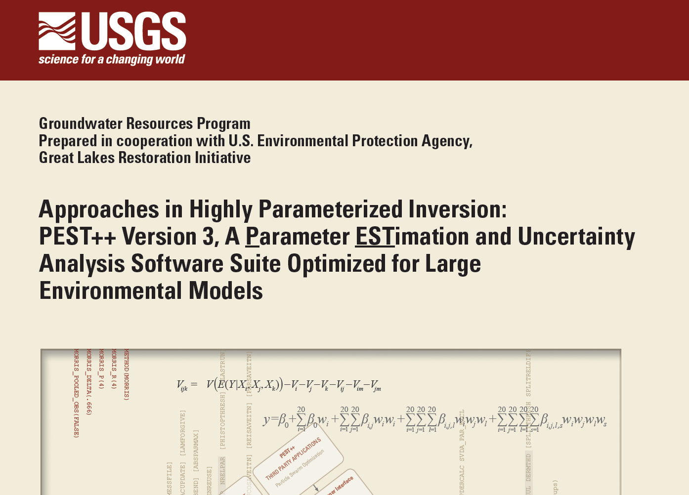
1994 – Meanwhile, elsewhere in the Parameter Estimation world
Doherty J (1994) PEST: a unique computer program for model-independent parameter optimisation. In 'Water Down Under 94'. Adelaide, S. Aust. pp. 551-554.
Why important?
Applies to any code (“universal”)
What does it need?
Code uses ASCII input/output
Runs in batch mode without user intervention
A concept that we’ll use this week

Slide 13
Automated Trial-and-Error:
Modeling
initial values
run model with values
run perturbed model
upgrade parameters
Sensitivity Calculation (e.g. Poeter and Hill 1998)
Δy’ ₌ y’(b+Δb) – y’(b)
Δb (b +Δb) – (b)
An import and computational expensive step – sensitivities of all adjustable parameter to all observations
aka the “Jacobian matrix”

Slide 14
Traditional
Stepwise
Data
Initial
acquisition
modeling
Analysis
Analysis
Modeling
Data
Modeling
acquisition
Results
Results
Haitjema (1995)

Slide 15
The “Goldilocks Principle” or “The law of Diminishing Returns”
understanding
enjoyment
# of ice cream cones
model complexity

Slide 16
Using Parameter Estimation to find the sweet spot
The ideal is that PE is a clever artificial intelligence-like approach that will develop the conceptual model and build an algorithm that results in an supremely well calibrated model quickly and efficiently
The real? A common management perception is that parameter estimation “does not work”, is “too hard”, and “takes too long”

Slide 17
Top 10 (well, 7) reasons why parameter estimation fails
User error
User error
User error
User error
User error
User error
User error

Slide 18
Backing up and setting realistic expectations
What can be expected of parameter estimation?
A quantifiable fit for a given conceptual model, but only if the modeler does their job…
might not be best fit (poorly posed or improper PE usage)
might not be only best fit (non-uniqueness)
might not be best model for the forecast of interest
Requires active user intervention to make sure that the resulting model is good (“same as it ever was…”)

Slide 19
Flip side of the argument…
What can be expected of manual trial-and-error?
A fit for a given conceptual model, but…
likely not best fit (how to defend?)
Not fully documented (how to describe subjective judgment?)
Few meaningful measures of model uncertainty available
Up to the user to make sure that the resulting model is correct (“same as it ever was…”)

Slide 20
This insight is not new
“The method of calibration used most often in real-world situations is manual trial and error…
However, the method is recognized to be labor intensive (therefore expensive), frustrating (therefore often left incomplete), and subjective (therefore biased and leading to results the quality of which is difficult to evaluate).”
Carrera and Neuman (1986)

Slide 21
Does that mean Trial-and-Error is passé? Absolutely not! Huge amount of insight comes from trial and error!
“However, recharge and hydraulic conductivity are of equal importance in the governing equation used in this model. Accordingly, an increase in one parameter can be offset changes in the other. This leads to an infinite number of hydraulic conductivity combinations and associated recharge rates that yield an acceptable head configuration. Therefore, the solution yielded by this model is not unique.”
- 1987 Randy

Slide 22
Does that mean Trial-and-Error is passé? Absolutely not! All PE starts with getting a model into the ballpark
The human brain is a great synthesizer of disparate data; cannot expect a PE code that only sees a small subset of the system to do same (Mike vs Isthmus example)
Infinite possibilities (and some wild derivatives) at the first iterations of PE run
Upshot: Getting into the ballpark first step to efficient PE

Slide 23
What do I mean by “into the ballpark”?
Misfit (SSOWR)
# of model runs

Slide 24
Take home point:
Why does 21st modeling need Parameter Estimation?
expedited "best fit" parameter values
Quantitative measure of:
quality of calibration
data shortcomings and needs
parameter and forecast uncertainty
more time to think about issues overlooked using
non-automated calibration
not automatic!

Slide 25
One last similarity between PE and trial-and error calibration…
Usually calibrate until project funds are exhausted (but with PE more insight about system is gained even if no time savings)

Slide 26
Why? Vexing Issues:
extreme parameter correlation
parameters for which only the ratio and not
their individual values can be determined
lack of sensitivity of parameters to calibration data
the data do not provide enough information
about a parameter
"can be difficult to identify...especially for
complicated models"
Poeter and Hill (1998)

Slide 27
Harnessing the Silicon for good
evaluation is done
using "weighted sum
substitute
of squared residuals” =
measurement objective function
Major advancement:
comparing apples
(heads) and oranges
run
(fluxes) to pears
evaluate fit
(concentration)
etc.

Slide 28
One last point before we get started:
Why spend the time, effort, and funding on a model?
We already know what we’ve measured (i.e., observations), so it it isn’t calibration....
Forecasts! Unlike many other classes, we will start out with, and then touch again and again on, focusing on applied modeling to make better forecasts

Slide 29
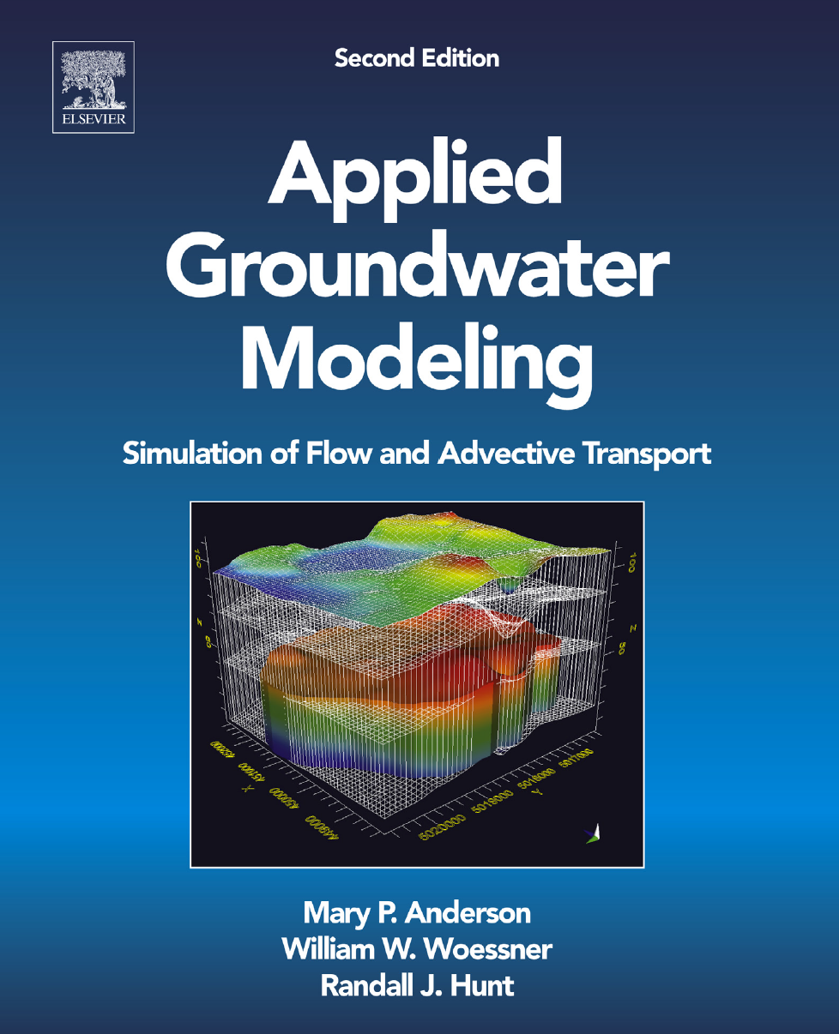
“Constructing a numerical model is never an end in itself. The model is always designed to answer a specific question or set of questions. In practice, modeling is most commonly performed to forecast”
- page 28

